Slide 1

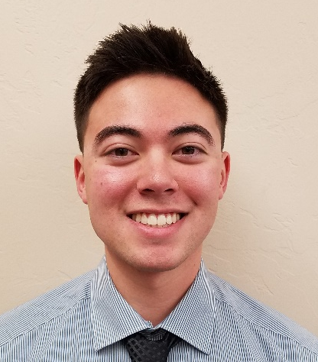

EagleSat-I Integration and Testing of 1U CubeSats
Sean Akana
Embry-Riddle Aeronautical University Aerospace Engineering, Senior
Presentation for
AZ/NASA Space Grant Symposium
April 21-22, 2017

Slide 2
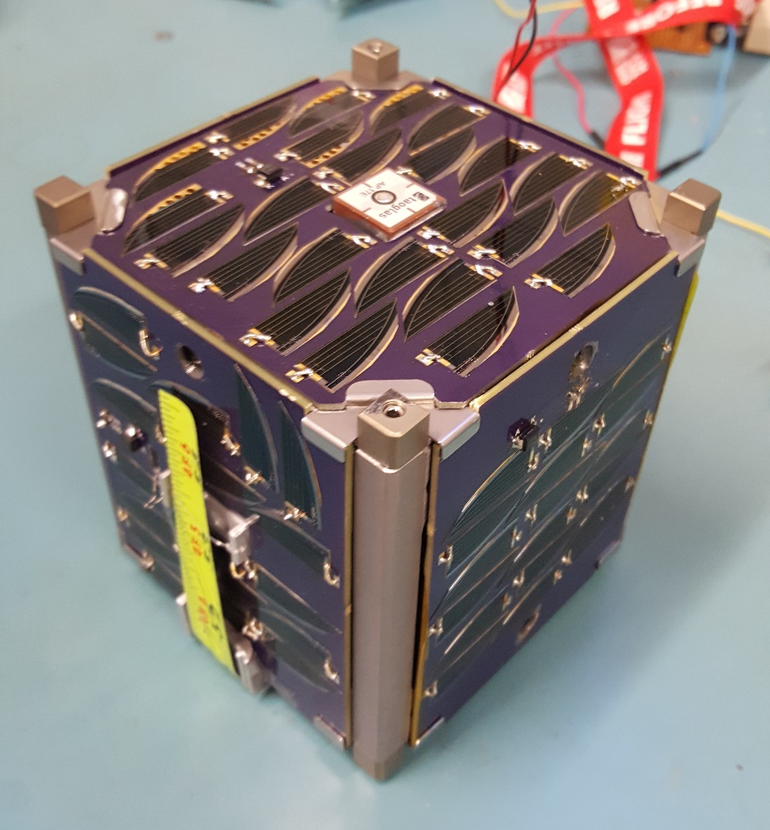
Overview
Satellite design
Day in the life
Vibration
Shock
Thermal bakeout
Results
Lessons learned

Slide 3
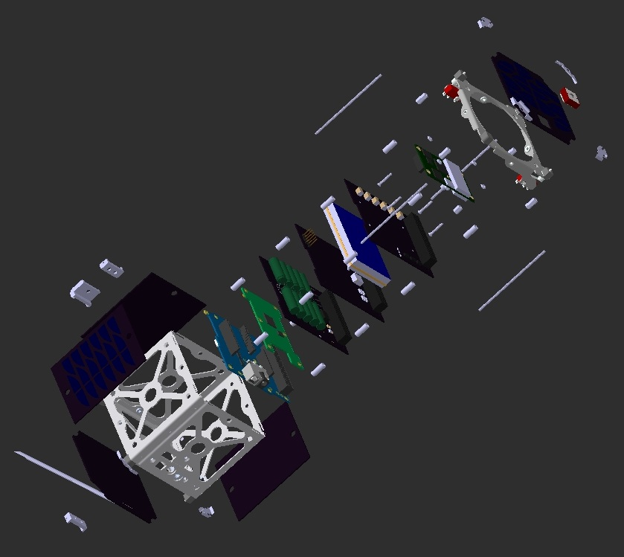
Satellite Design

Slide 4
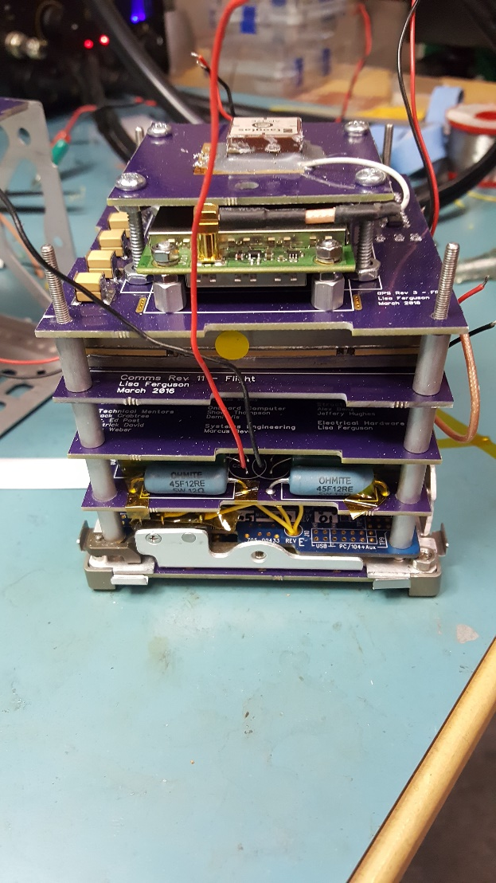
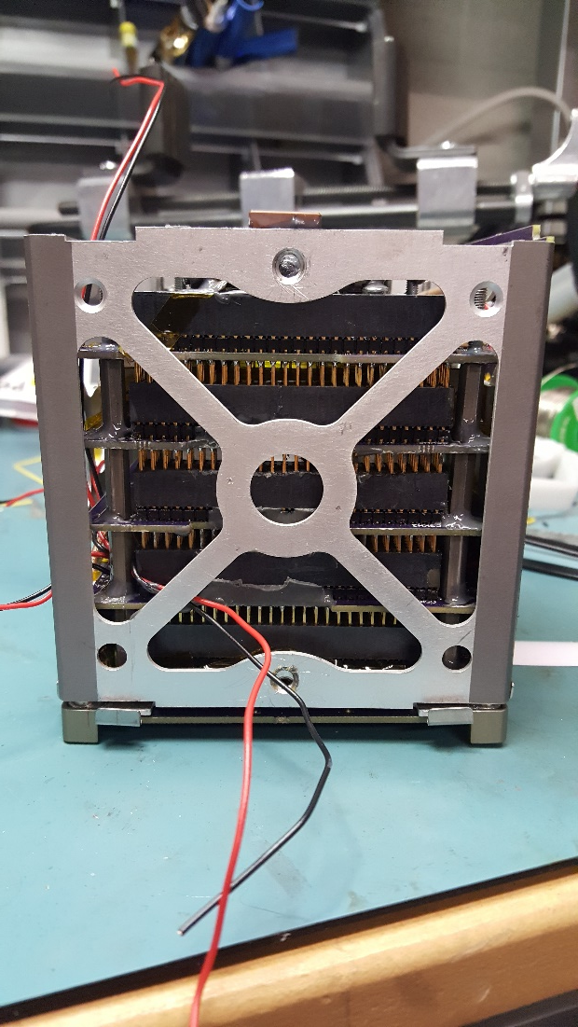
Satellite Design

Slide 5
Day In The Life
Test of satellite functionality
Satellite shall:
Prevent storage of power
Constrain deployables
Prevent transmissions

Slide 6
Vibration
Test of satellite structural survivability
Satellite shall:
Be structurally adequate to survive vibration parameters in each axis
Random Vibration
Sine Vibration

Slide 7
Shock
Test of satellite structural survivability
Satellite shall:
Be structurally adequate to survive shock parameters in each axis

Slide 8
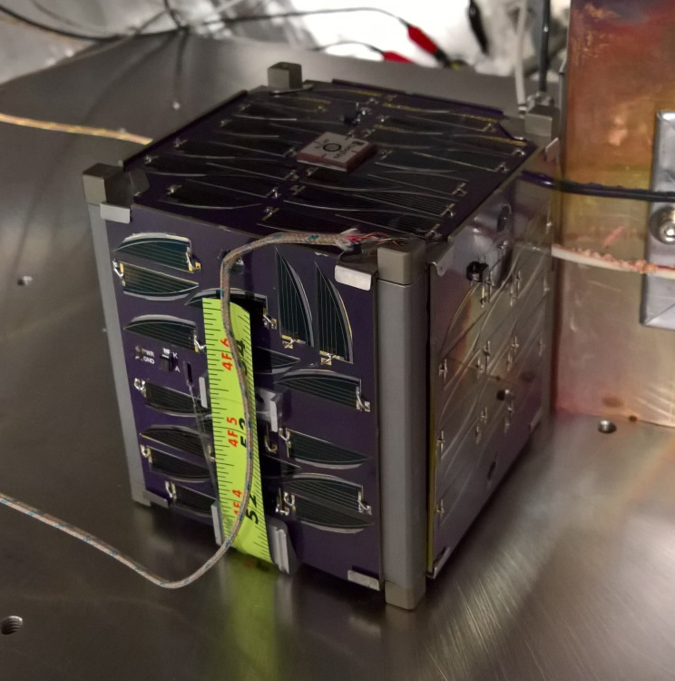
Thermal Bakeout
Test of satellite outgassing
Satellite shall:
Achieve a sufficient temperature to clean the satellite for several hours at near vacuum pressures

Slide 9
Results
Failed:
Day in the life: One (1) time
Vibration: Three (3) times
Shock: One (1) time
Passed:
Day in the life: Several times
Vibration: Two (2) times
Shock: One (1) time
Thermal bakeout: One (1) time

Slide 10
Lessons Learned
Day in the life
Kapton Tape all electrical components
Test full stack for functionality before finishing integration
Build a little; test a little

Slide 11


Lessons Learned
Vibration
Epoxy and Loctite fasteners
Torque to proper values

Slide 12
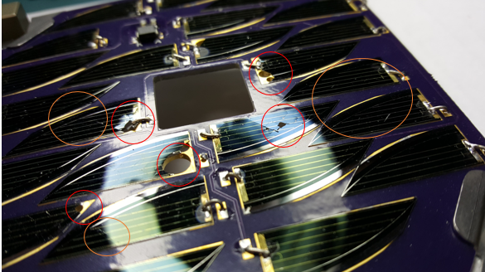
Lessons Learned
Shock

Slide 13
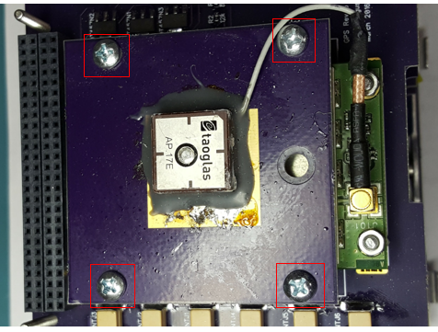
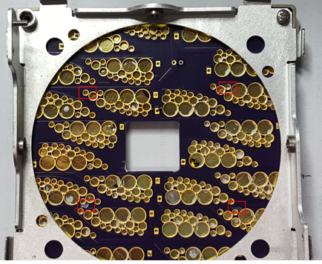
Lessons Learned
Shock

Slide 14

Lessons Learned
Shock
Epoxy and Loctite Fasteners
Torque values
Limit stack separation

Slide 15





Acknowledgements
Dr. Gary Yale
EagleSat-1 Team
Embry-Riddle Aeronautical University
NASA Arizona Space Grant Consortium
Wood & Douglas (UK)
Ignite Undergraduate Research
Arizona Near Space Research

Slide 16
Questions
Sean Akana
(360) 515-1718
akanas1@my.erau.edu

